Slide 1
Energy Harvesting
Utilizing Piezoelectric technology to reduce urban temperatures in India.

Slide 2
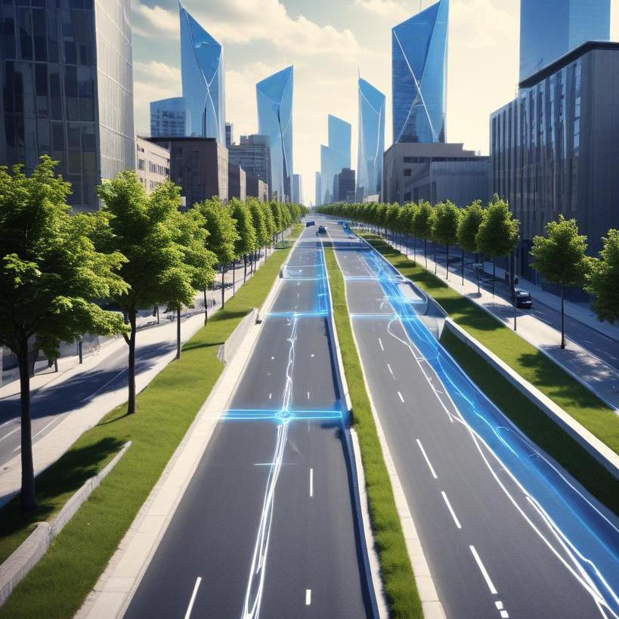
Introduction
This presentation focuses on energy harvesting methods, particularly piezoelectric technology, to combat urban heat in Indian metropolitan areas. We will explore its significance, impact on temperature control, and implementation strategies.

Slide 3
Empathise :
Metropolitan cities are experiencing higher temperatures due to several factors, primarily caused by Urbanization and Human activities.
High Energy Consumption : Factories ,Air conditioners, vehicles, e.t.c
Traffic and vehicular pollution.

Slide 4
Define :
In order to decrease the higher temperatures in urban area’s. We need to decrease the Thermal Emissions.
Major cause of higher energy is releasing excess thermal emissions, and lack of greenery and water bodies.

Slide 5
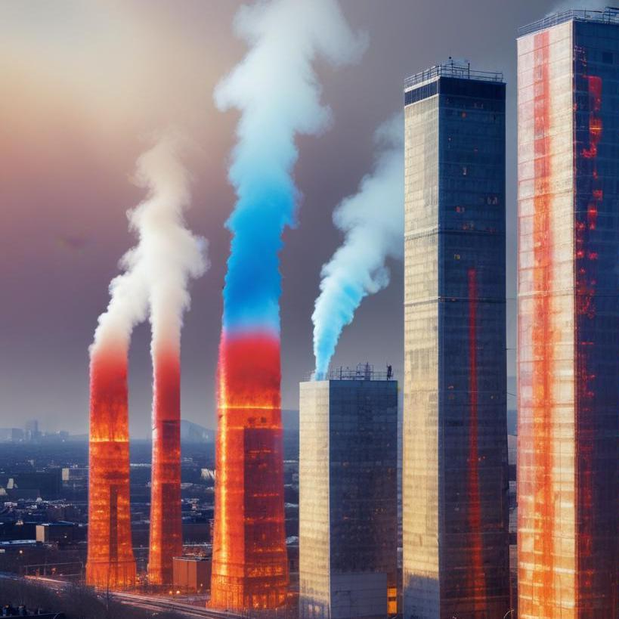
Role of Thermal Emission
Thermal emissions in urban environments result from various sources, such as vehicular traffic, industrial activities, and HVAC systems. These emissions contribute significantly to the urban heat island effect, where city areas experience higher temperatures than surrounding rural areas.

Slide 6
Ideate :
Piezoelectric Technology
The effect behind the technology is Piezoelectric effect which converts the Mechanical energy to Electrical energy.

Slide 7
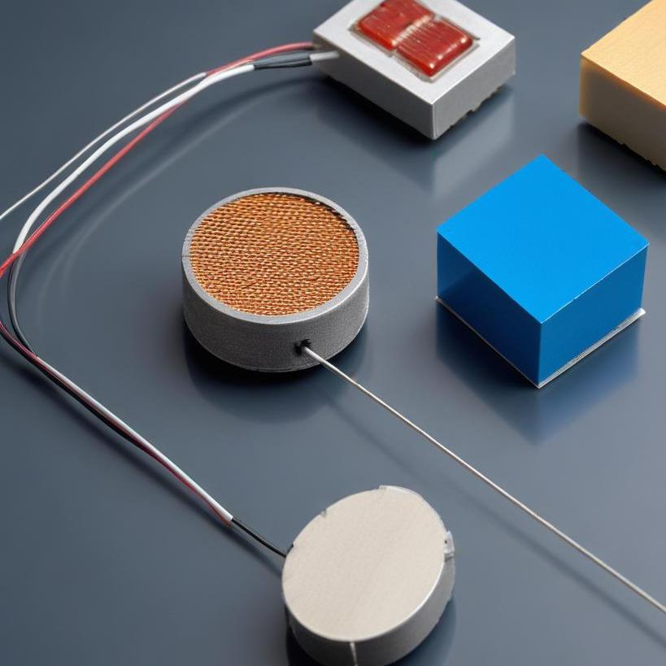
Overview of Piezoelectric Effect
The piezoelectric effect describes the ability of certain materials to generate electrical voltage when mechanical stress is applied. This phenomenon can be harnessed in various applications, such as sensors and energy harvesting systems. In urban contexts, piezoelectric materials can be embedded in roads and walkways to convert kinetic energy from pedestrian and vehicle movements into usable electrical energy, promoting sustainability and energy efficiency.

Slide 8
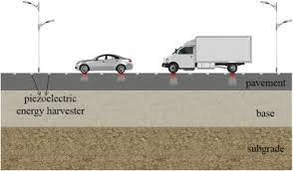
Prototype :
In India largest means of transport is road ways.
To implement Piezoelectric Technology under the road has a great potential for sustainable energy generation.
In pavement region (or) under the concrete, asphalt layers these piezoelectric ceramics, polymers should be installed. So, that pressure ( Mechanical energy ) from heavy vehicles causes to generate an electric charge.
More pressure causes more electricity generaton.

Slide 9
Flow chart :
1.Material Installation
4.Stores in Supercapacitors or batteries
5.Utilizing the electrical energy
2.Creating Pressure on them
3.Generates electrical energy
6.Sustainable Urban Infrastructure

Slide 10
Before Implementation
Planning and setup :
Site Selection : Highways, Toll roads, Express Ways.
Material Selection : PiezoElectric ceramics and polymers.
Structural Integration : Asphalt (or) Concrete.
Energy Storage : Batteries and Supercapacitors.

Slide 11
After Implementation
Energy generation and utilization :
Generation Process : Apply Pressure →Generates Energy.
Utilization : Charging EV vehicles, Traffic signals, board signs e.t.c
Monitoring and Maintainance : IOT based sensors for indicating the levels of electricity generation and wear & tear of panels,ceramics.

Slide 12
Potential Benefits
Renewable energy from existing road infrastructure.
Can reduce Highway electric cost
Works 24/7 with continuous vehicle movement
Supports smart city/country and sustainable initiatives.
Reduces the air pollution from the thermal power plants.

Slide 13
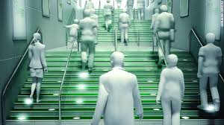
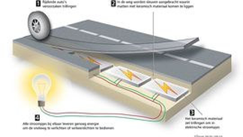
Test and Conclusion:
At present, Piezoelectric Technology is already utilizing in china and developing in india.
Researches and institutions across the country exploring the various application of Piezoelectric Materials.

Slide 14
Thank you!
Do you have any doubts?
Presentation link : https://github.com/Vamc-24/Piezoelectric-Technology

